Slide 1
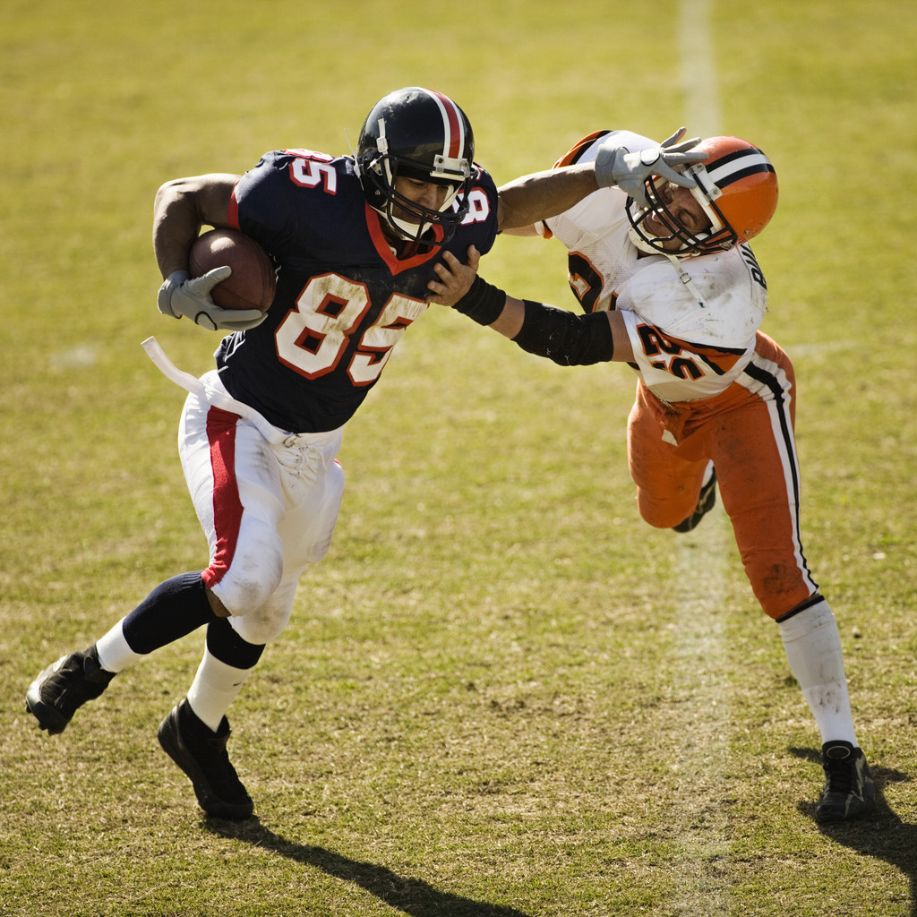
Tackle Football Overview

Slide 2
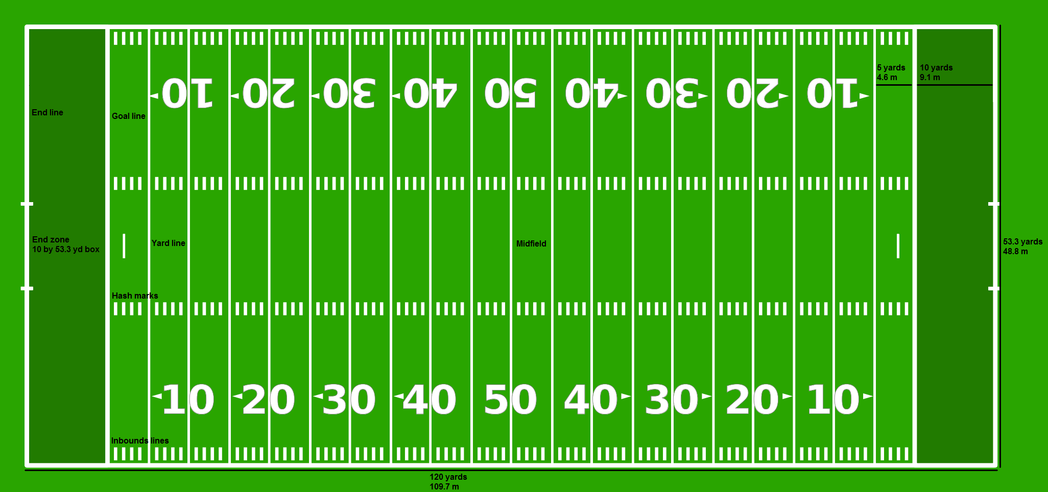
Basic Field Set-up
Line of Scrimmage (LOS) – The imaginary line that separates the offense and the defense at the beginning of each play.

Slide 3
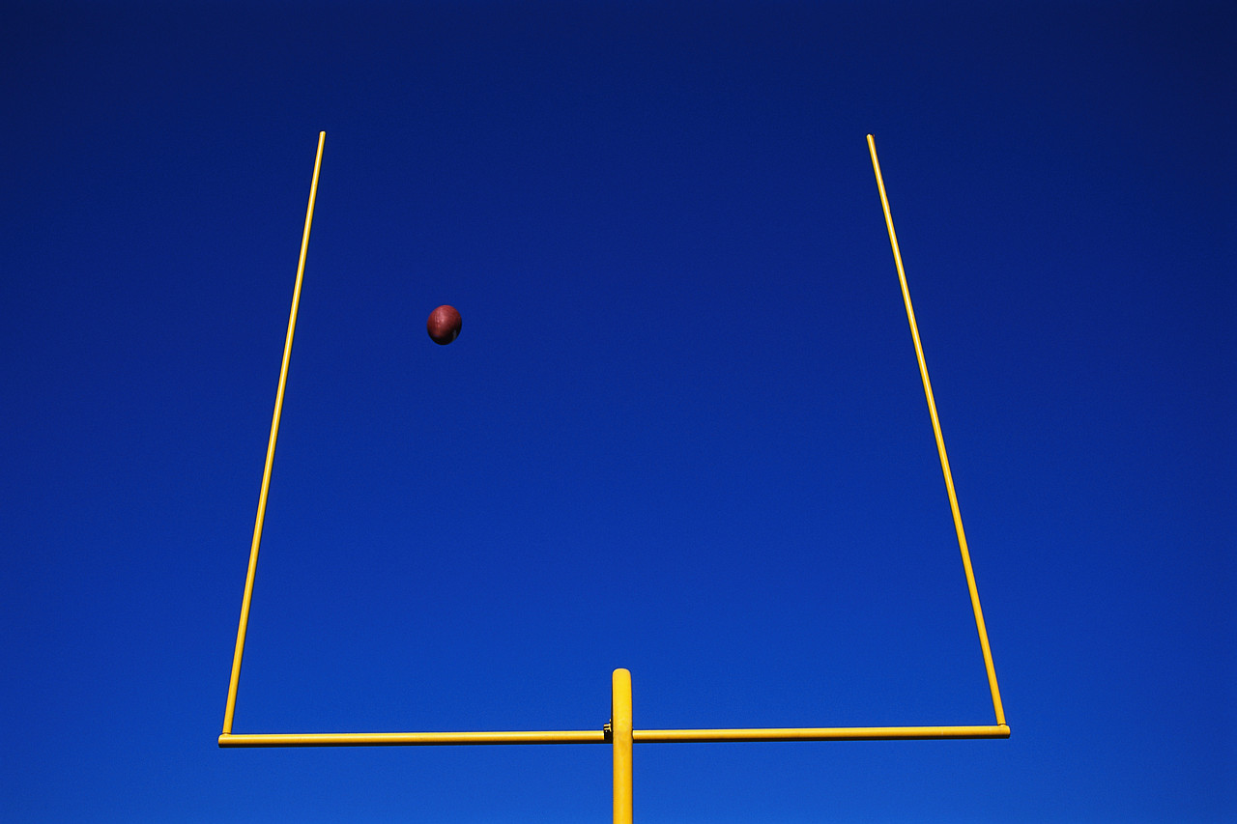
Scoring
Touchdown – Made by running the ball into or catching the ball in the end zone. Worth 6 points.
Point After Touchdown (PAT) – Made by kicking the ball after a touchdown through the goal post. Worth 1 point.
2-Point Conversion – Made by running a play and either running the ball into or catching the ball in the end zone. Worth 2 points.
Field Goal – Made by kicking the ball through the goal post before scoring a touchdown. Worth 3 points.
Safety – Made by getting the offense down inside their own end zone. Worth 2 points.

Slide 4
Offensive Positions
Quaterback – Leader of the offense. Usually the one to throw the ball or hand it off.
Tailback – Usually the best runner. Can also block and catch a pass.
Fullback – Usually the best blocking runningback. Can also run the ball and catch pass.
Slot/Wing Back – Lined up off the line of scrimmage outside the linemen. A good runner and receiver.
Split end – Lined up on the line of scrimmage away from the linemen. A good pass catcher.
Tight end – Lined up on the line of scrimmage by the linemen. A good blocker and pass catcher.
Center – The middle of the linemen on the line of scrimmage. Snaps the ball to the quarterback and is the leader of the linemen.
Guard – Line up on both sides of the center. They usually only block.
Tackle – Line up on both sides of the guards. They usually only block.
You must have 7 offensive players on the line of scrimmage.
Only the players located on each end of the line of scrimmage may catch a pass.
Only players lined up behind the line of scrimmage may run the football.

Slide 5
Offensive Formations
Offensive formations are named based on how the players line up.
If the formation is balanced with one wide receiver on each side, it is a Pro formation. Two receivers on each side is a Doubles formation.
Three receivers on one side is a Trips formation.
Three receivers on one side and two receivers on the other is a Gone formation.
PRO I Formation
TB
FB
QB
Z
X
T
G
C
G
T
TE

Slide 6
Defensive Positions
Defensive Linemen:
Tackle/Nose guard – Defensive linemen lined up closest to the ball on the line of scrimmage.
Defensive end – Defensive linemen lined up across from the widest lineman on the line of scrimmage.
Linebackers:
Middle – Leader of the defense. Lined up behind the defensive linemen.
Outside – Lined up on either side of the middle linebacker(s).
Defensive Backs:
Safety – Defensive back lined up behind the linebackers. Pass coverage leader.
Cornerbacks – Lined up across from the widest offensive players. Good pass cover players.
No specific number of players need to be lined up on the line of scrimmage.

Slide 7
Defensive Formations
Defensive Formations are named base on how many linemen and linebackers there are.
3 Linemen + 3 Linebackers = 3 – 3 Defense
4 Linemen + 4 Linebackers = 4 – 4 Defense
5 Linemen + 3 Linebackers = 5 – 3 Defense
4 – 4 Defensive Formation
FS
W
M
ST
S
C
C
DE
NG
T
DE
X
T
G
C
G
T
TE
Z
QB

