Slide 1
Basketball
Guided Notes

Slide 2
History
Dr. James Naismith, a Canadian physical education student and instructor at a YMCA Training School in Springfield Mass. Invented the game.
Wanted a game that would keep his students occupied and provide proper levels of fitness during the long New England winters.
After rejecting other ideas for being too rough or not suited for walled-in gymnasiums, he wrote the original basic rules and nailed a peach basket onto a 10-foot elevated track.
Each scored basket was worth 1 point and the team with the most points won.
The first ball used was a soccer ball.
The first official game was played in the YMCA gym on Jan. 20, 1892, with only 9 players, on a court half the size of a present-day NBA court.
Basketball was given its name by one of Naismith’s students.

Slide 3
Basic Set Up
Played with 2 team of 5 players trying to score points on each other.
The hoop (basket) is set at 10 feet.
Points are scored by passing the ball through the basket from above.
1 point if made from the foul line during a foul shot.
2 points if made inside the 3-point arc during regular play.
3 points if made outside the 3-point arc during regular play.
The ball may be advanced by bouncing it (dribbling) or passing it between teammates.
Disruptive physical contact (fouls) is not permitted and there are restrictions on how the ball can be handled (violations).

Slide 4
Scoring and Skills
Field Goal – A shot made from anywhere on the court during regular game play. Can count as 2 or three points.
Free Throw – An unguarded shot by a player who has been fouled. It is take from behind the free throw (foul) line. Each made attempt counts as 1 point.
Dribbling – Moving the ball by bouncing it. This skill may begin and end with two hands, but subsequent contacts can only be made with on hand.
Shooting – Throwing the ball in order to make a basket.
Passing – Throwing the ball from one player to a teammate.
Pivoting – Stepping once or more with one foot while the other foot remains stationary.

Slide 5
Fouls
Foul – Breaking a rule which usually involves physical contact with another player.
Blocking – A foul involving contact which impedes the progress of an opponent. A player may NOT enter the path of a moving player without giving them a chance to stop or change direction. Holding the arms outward to keep a player from going around you is a form of blocking.
Charging – An offensive player moves into an opponent whose position is already established or “set”.
Reach/Hack – A player hits the arm or hand of a player holding the ball. If the player is in the act of shooting, they are awarded 2 (or 3) free throws.
Pushing – Any unnecessary contact between players, by either offensive or defensive players.
Holding – A player holds an opponent without the ball.
Unsportsmanlike Conduct – A player, coach, or fan demonstrates a severe breech of sportsmanship. In this circumstance, the offending team is penalized by a technical foul and the opposing team is awarded 2 free throws. Two technical fouls result in an ejection from the game.

Slide 6
Violations
Violation – Breaking a rule which does not involve another player. No free throws are awarded for violations.
Traveling – Moving illegally with the ball.
When not dribbling a player may pivot, but cannot move the pivot foot.
A player may lift the pivot foot to jump, but must pass or shoot before touching the floor again.
A player must release the ball before lifting the pivot foot when attempting to dribble.
A player may not take more than 2 steps before dribbling, passing, or shooting.
Carry – When the ball noticeably comes to rest in the palm of the hand while dribbling.
Double Dribble – When a player stops and then continues dribbling, or when a player dribbles with two hands at the same time.
Kicking – When a player kicks the ball.

Slide 7
Violations Cont.
Timing Violations
3 Seconds in the Key – An offensive player cannot stay in the key for more than 3 consecutive seconds. If a player receives the ball in the key they have 3 seconds to either shoot or exit the key.
5 Seconds to Throw-In – Offensive players have 5 seconds to inbound the ball on a throw-in.
10 Second Violation – The offensive team must get the ball across half-court before a ten-second count occurs.

Slide 8
Dribbling Cues
Finger Pads
Knees Bent
Head Up
Push the Ball

Slide 9
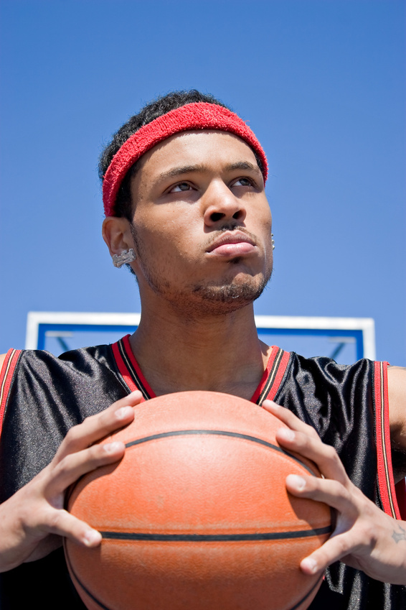
Chest/Bounce Pass Cues
Thumbs up to thumbs down
Step forward
Look and step at target
2/3 for bounce pass

Slide 10
Shooting
Balance
Elbow under ball
Extension
Follow through

Slide 11
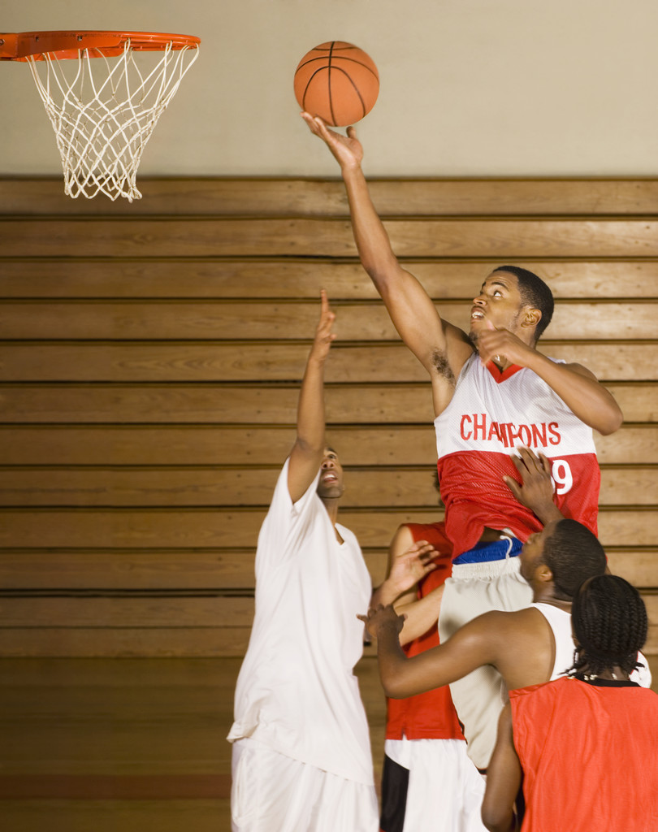
Lay Up
Use Backboard
Jump off opposite foot
Follow through

Slide 12
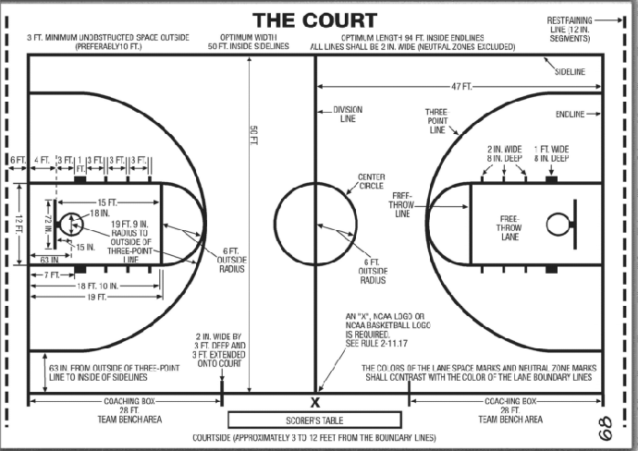
Court Layout

